Slide 2
Overview
This chapter discusses the management of credit risk in a loan (asset) portfolio context. It also discusses the setting of credit exposure limits to industrial sectors and regulatory approaches to monitoring credit risk. The National Association of Insurance Commissioners has also developed limits for different types of assets and borrowers in insurers’ portfolios.

Slide 3
Simple Models of Loan Concentration
Migration analysis
  Track credit rating changes within sector or pool of loans.
  Rating transition matrix (Transition probabilities)
Concentration Limits
  External limits set on the maximum loan size that can be made to an individual borrower

Slide 4
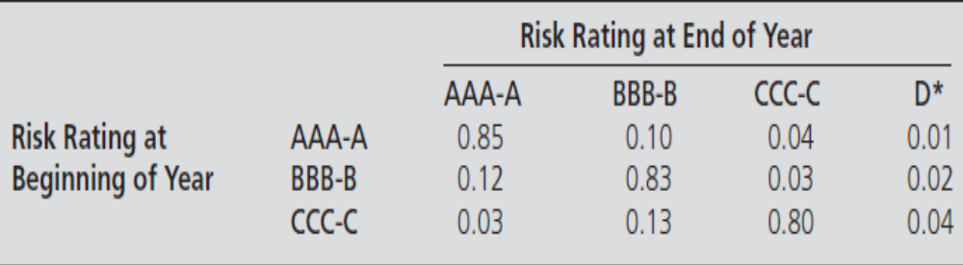
Rating Transition Matrix - Example

Slide 5
Simple Models of Loan Concentration
Concentration limits
  This simple model requires management to set some firm external limit on the maximum amount of loans that will be made to an individual borrower or sector.
  Concentration limit
  = Maximum loss as a percent of capital ÷ Loss rate.

Slide 6
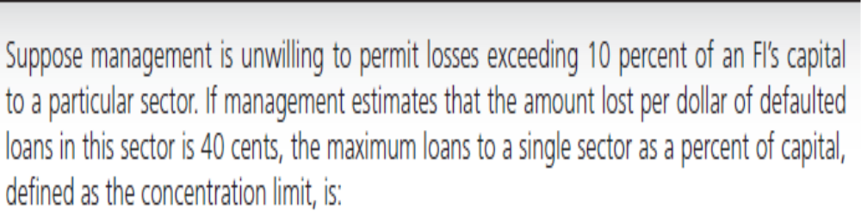
Concentration limits - Example

Slide 7
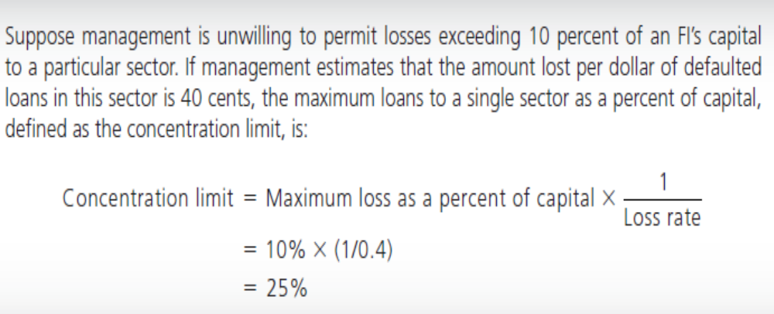
Concentration limits - Example

Slide 8
Concentration limits - Example
what would the concentration limit be if the loss rate on bad loans is 25 cents on the dollar? (40%)
what would the concentration limit be if the maximum loss (as a percent of capital) is 15 percent instead of 10 percent? (60%)

Slide 9
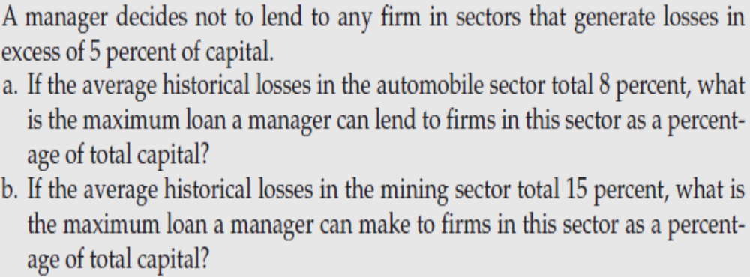
Concentration limits – Practice Q1

Slide 10
Concentration limits – Practice Q1
Part a)
Concentration limit
= (Maximum loss as a percent of capital) x (1/Loss rate)
= .05 x 1/0.08
= 62.5 percent of capital is the maximum amount that can be lent to a firm in the automobile sector.

Slide 11
Concentration limits – Practice Q1
Part b)
Concentration limit
= (Maximum loss as a percent of capital) x (1/Loss rate)
= .05 x 1/0.15
= 33.3 percent of capital is the maximum amount that can be lent to a firm in the mining sector.

Slide 12
Concentration limits – Practice Q2
An FI has set a maximum loss of 2 percent of total capital as a basis for setting concentration limits on loans to individual firms. If it has set a concentration limit of 25 percent of capital to a firm, what is the expected loss rate for that firm?

Slide 13
Concentration limits – Practice Q2
Concentration limit
= (Maximum loss as a percent of capital) x (1/Loss rate)
25 percent = 2 percent x 1/Loss rate
⇒ Loss rate = 0.02/0.25
= 8 percent

Slide 14
Diversification & Modern Portfolio Theory
To the extent that an FI manager holds widely traded loans and bonds as assets or, alternatively, can calculate loan or bond returns, portfolio diversification models can be used to measure and control the FI’s aggregate credit risk exposure.
The fundamental lesson of modern portfolio theory (MPT) is that by taking advantage of its size, an FI can diversify considerable amounts of credit risk as long as the returns on different assets are imperfectly correlated with respect to their default risk adjusted returns.
That is, if there is negative correlation across borrower default probabilities, then a portfolio of loans may have less risk than an individual loan, all else equal.

Slide 15
Applying Portfolio Theory to Loans
Require
  (i) expected return on loan (measured by all- in-spread);
  (ii) loan risk;
  (iii) correlation of loan default risks.

Slide 16
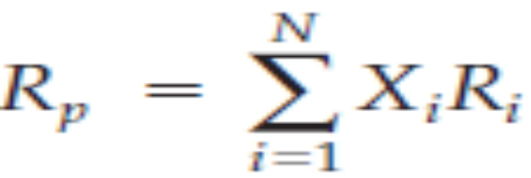
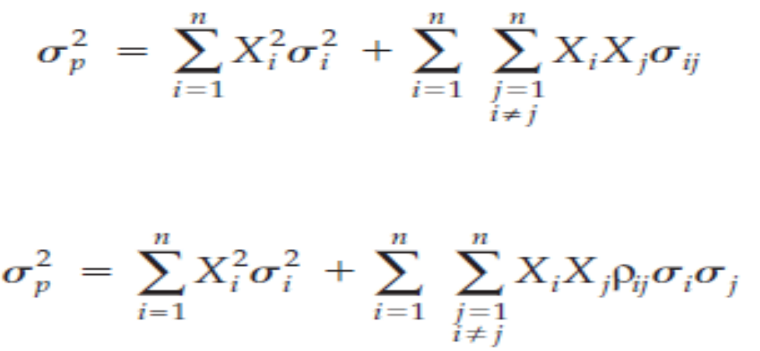
Diversification & Modern Portfolio Theory

Slide 17
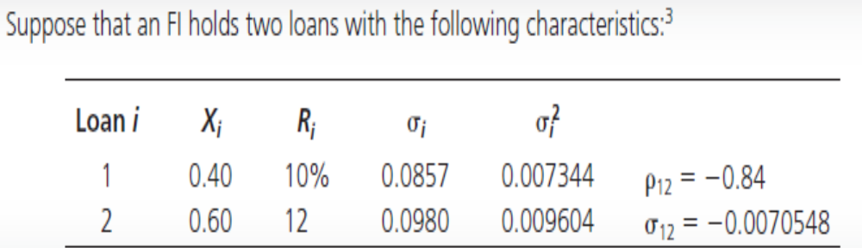
Modern Portfolio Theory - Example

Slide 18
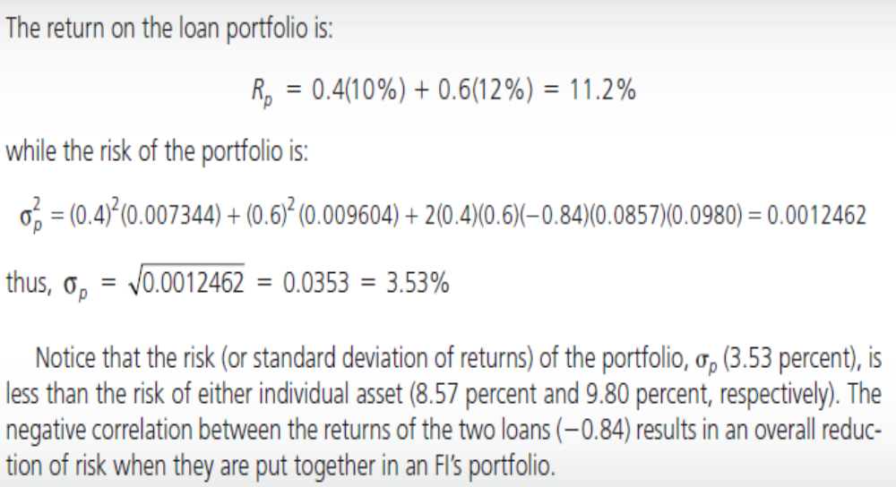
Modern Portfolio Theory - Example

Slide 19
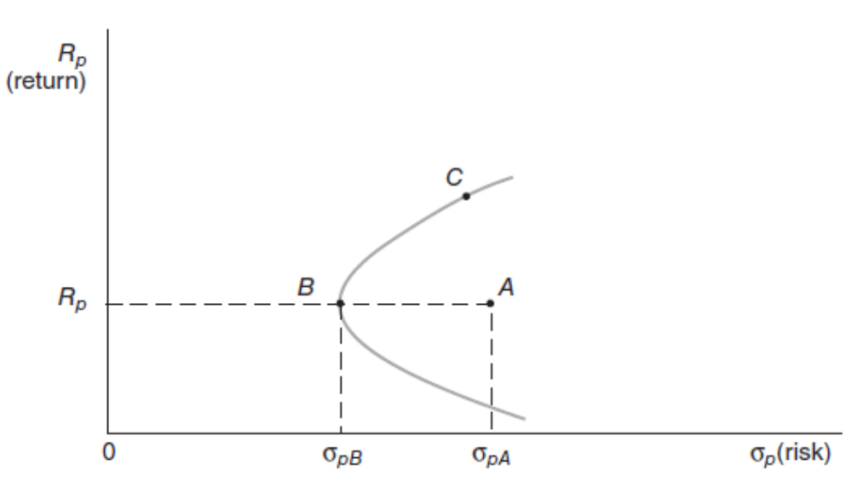
Modern Portfolio Theory – Efficient Frontier

Slide 20
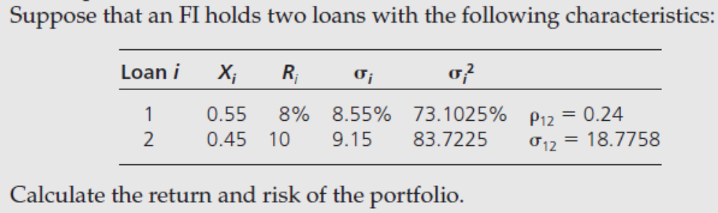
Modern Portfolio Theory – Practice Q3

Slide 21
Modern Portfolio Theory – Practice Q4
Expected Return on Portfolio
= (0.55* 0.08) + (0.45*0.10)
= 8.9%
Standard Deviation of Portfolio
= [(0.55^2)(0.00731025) + (0.45^2)(0.00837225) +
2(0.55)(0.45)(0.24)(0.0855)(0.0915)] ^0.5
= 0.0695 or 6.95%

Slide 22
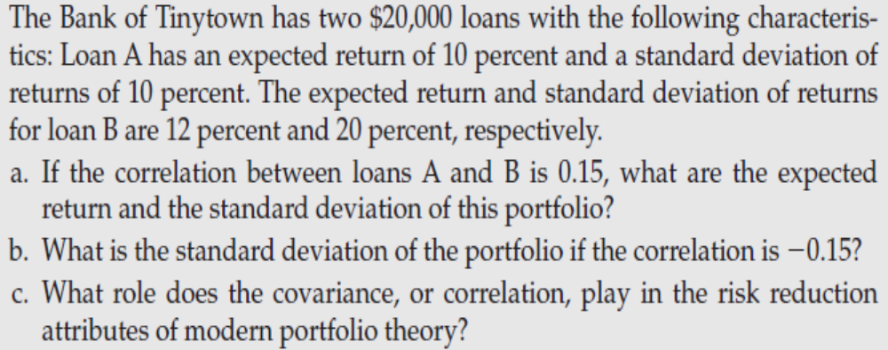
Modern Portfolio Theory – Practice Q4

Slide 23
Modern Portfolio Theory – Practice Q4
X_{A} = X_{B} = $20,000/$40,000 = .5
Expected return
= 0.5(10%) + 0.5(12%)
= 11 percent
Standard deviation
= [0.5²(10)² + 0.5²(20)² + 2(0.5)(0.5)(10)(20)(.15)]^{½}
= 11.83 percent

Slide 24
Modern Portfolio Theory – Practice Q4
Standard deviation
= [0.5²(10)² + 0.5²(20)² + 2(0.5)(0.5)(10)(20)(-0.15)]^{½}
= 10.49 percent

Slide 25
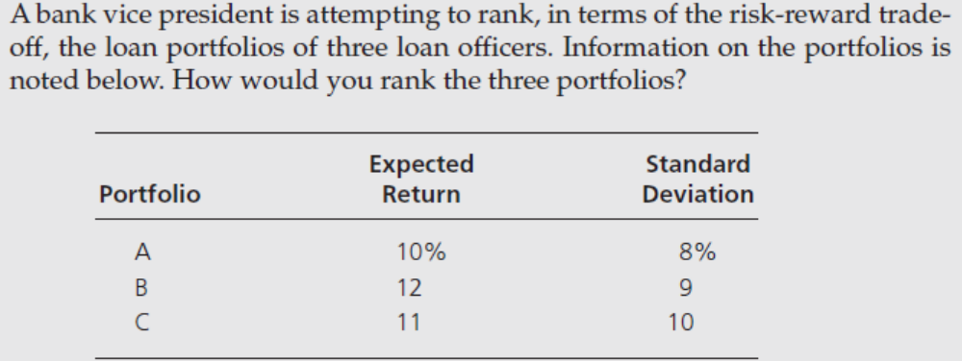
Modern Portfolio Theory – Practice Q5

Slide 26
Modern Portfolio Theory Models for loans
Moody’s Analytics portfolio Manager Model
The Moody’s Analytics model is unique in the way it estimates the return, risk, and correlations between loans in an FI’s loan portfolio.
Once these variables are estimated in the Moody’s Analytics Portfolio Manager model, they are then incorporated into the standard MPT equations to get an estimate of the risk and return of the FI’s loan portfolio.
The Moody’s Analytics Credit Monitor model examines Moody’s Analytics’ method of evaluating default risk on an individual loan (so-called expected default frequency, or EDF).

Slide 27
Moody’s Portfolio Manager Model
  Moody’s Measures these as follows:
  R_{i} = AIS_{i} - E(L_{i})
  = AIS_{i} - [EDF_{i} × LGD_{i}]
  σ_{i} = UL_{i}
  = σ_{Di} × LGD_{i}
  = [EDF_{i}(1-EDF_{i})]^{½} × LGD_{i}
  ρ_{ij} = correlation between systematic return components of equity returns of borrower i and borrower j.
Notes:
Return on the loan (R_{i} ) measured by All In Spread (AIS) minus the expected loss on the loan.
EDF is expected default frequency and LGD is the amount of the Loss Given Default has occurred
Risk of the loan σ_{i} is the volatility of the loan’s default rate times the LGD. Recall that the variance of a binary random variable is the product of the probability of the event occurring and 1 minus the probability of the event occurring. In this case, that means EDF times (1-EDF). The standard deviation, σ_{Di} , is the square root of the variance.

Slide 28
Moody’s Portfolio Manager Model
Return on Loan (Ri)
The return on a loan is measured by the so-called annual all-in-spread (AIS), which measures annual fees earned on the loan by the FI plus the annual spread between the loan rate paid by the borrower and the FI’s cost of funds.
Deducted from this is the expected loss on the loan [E(L i )]. This expected loss is equal to the product of the expected probability of the borrower defaulting over the next year, or its expected default frequency ( EDF i) times the amount lost by the FI if the borrower defaults (the loss given default, or LGD i ).
Also, if desired, the return on the loan can be expressed in excess return form by deducting the risk-free rate on a security of equivalent maturity.

Slide 29
Moody’s Portfolio Manager Model
Risk of Loan (standard deviation i)
The risk of the loan reflects the volatility of the loan’s default rate ( Di ) around its expected value times the amount lost given default ( LGD i ).
The product of the volatility of the default rate and the LGD is called the unexpected loss on the loan (ULi ) and is a measure of the loan’s risk, or sd i .
To measure the volatility of the default rate, assume that loans can either default or repay (no default).
Then defaults are binomially distributed, and the standard deviation of the default rate for the i th borrower ( SD Di ) is equal to the square root of the probability of default times 1 minus the probability of default [(EDF)(1 - EDF)]^0.5.

Slide 30
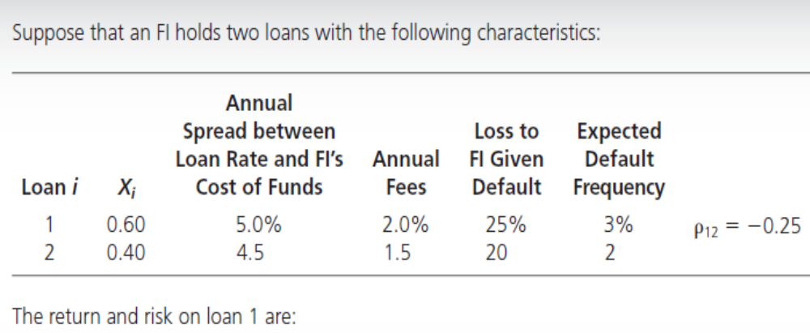
Moody’s Portfolio Manager Model - Example

Slide 31
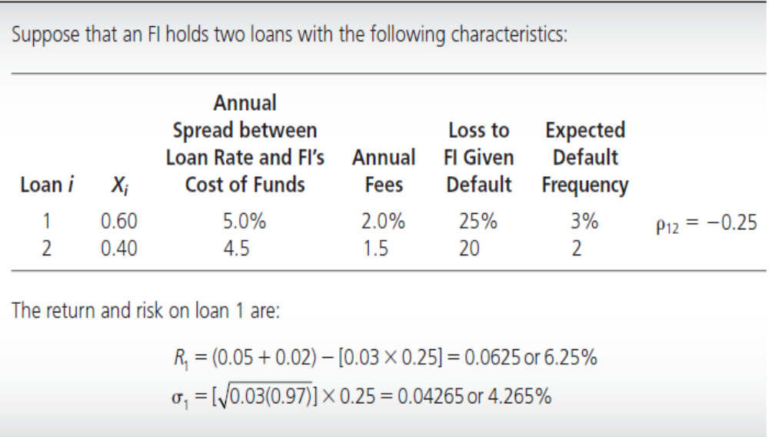
Moody’s Portfolio Manager Model - Example

Slide 32
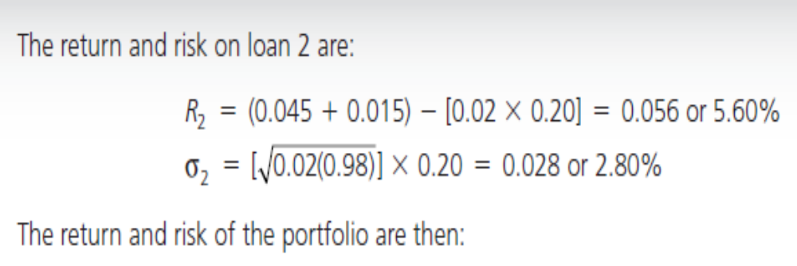
Moody’s Portfolio Manager Model - Example

Slide 33
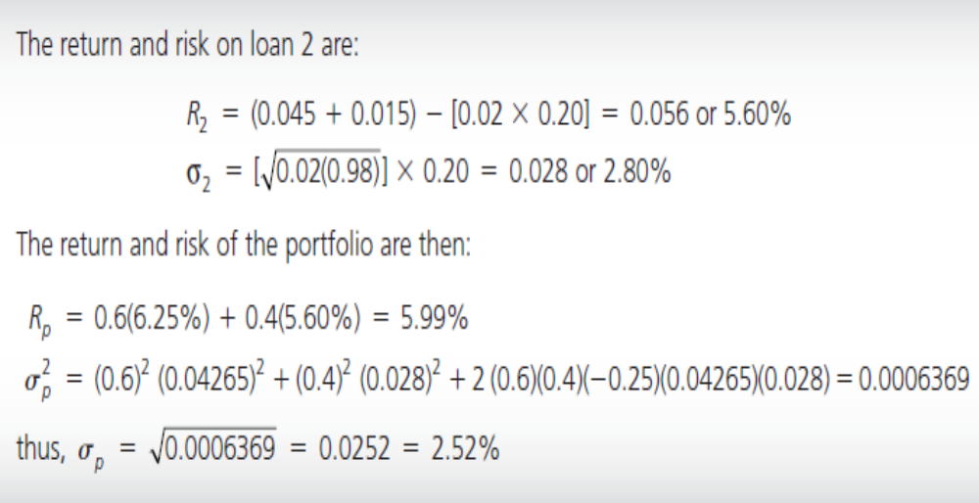
Moody’s Portfolio Manager Model - Example

Slide 34
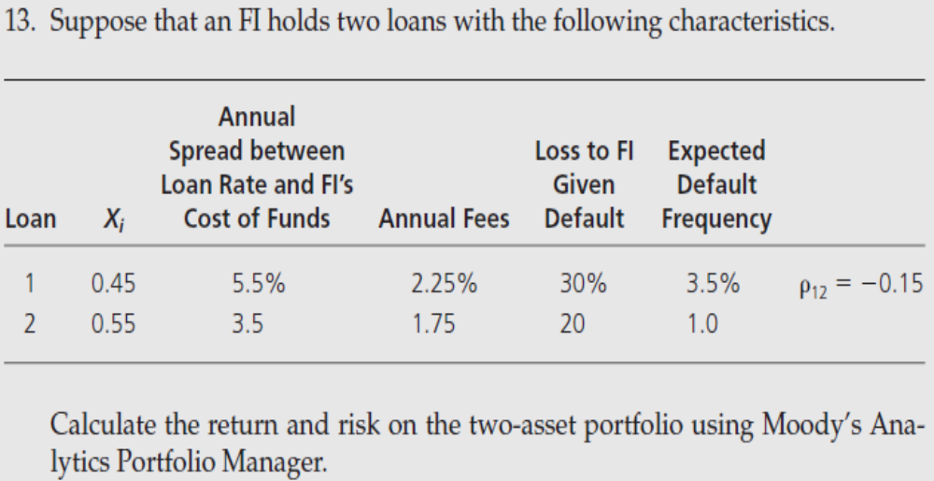
Moody’s Portfolio Manager Model – Practice Q6

Slide 35
Moody’s Portfolio Manager Model – Practice Q6
Expected return on Loan 1
= AIS_{i} – E(L_{i})
= (0.055 + 0.0225) – (0.035 x 0.30)
= .067 or 6.70 percent
Risk of the loan 1
= σ_{Di} x LGD_{i}
= [0.035(0.965)]^{½} x 0.30
= 0.0551 or 5.51 percent

Slide 36
Moody’s Portfolio Manager Model – Practice Q6
Expected return on Loan 2
= AIS_{i} – E(L_{i})
= (0.035 + 0.0175) – (0.01 x 0.20)
= .0505 or 5.05 percent
Risk of the loan 2
= σ_{Di} x LGD_{i}
= [0.01(0.99)]^{½} x 0.20
= 0.0199 or 2 percent

Slide 37
Moody’s Portfolio Manager Model – Practice Q6
Expected return on Portfolio
=(0.45*0.067) + (0.55*0.0505)
= .058 or 5.80 percent
Risk of the portfolio
= [0.45²(5.51)² + 0.55²(2)² + 2(0.45)(0.55)(5.51)(2)(-.15)]^{½}
= (6.14 + 1.21 - 0.82)^0.5
= 2.55 percent

